Slide 1

Token Merging Perceiver
Matthew Zhou

Slide 2
Motivation
Complexity of attention is quadratic in input sequence length
Transformer models have max sequence lengths (512/1024)
Cannot capture very long-range relationships between tokens
Long training times and latencies for prediction

Slide 3
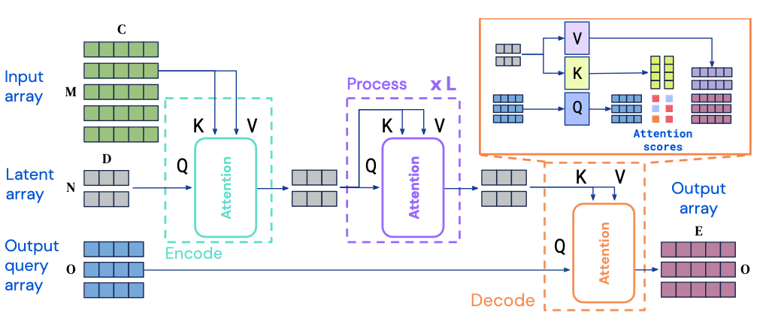
Perceiver I/O
Tame quadratic complexity of Transformers with cross-attention
Encode by mapping input sequence to latent space – O(MN)
Self attention using latent tokens – O(N^2)
Decode into output array – O(NO)
Jaegle, et al. Perceiver io: A general architecture for structured inputs & outputs, 2022

Slide 4
Perceiver I/O
Complexity is linear in input sequence length
Much longer sequence lengths
Can feed in raw UTF-8 bytes for language tasks, instead of tokenizing
Tokenization - “Hard to maintain, introduces engineering overhead, and adds needless complexity to language model”
Can feed in full image, instead of patches
Can handle multi-task queries through task-specific tokens

Slide 5
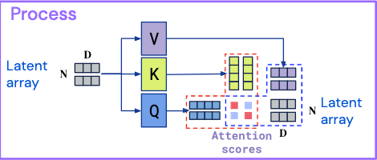
Limitations
Can still be expensive – latent space is often 256x1280
BERT has max sequence length of 512
Bulk of computation is still quadratic in number of latents

Slide 6
Proposed Method
Utilize token merging to reduce the number of latent tokens
Keep the most important latent tokens
Reduce FLOPs while maintaining accuracy

Slide 7
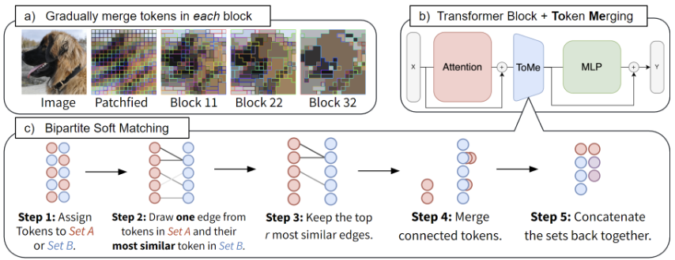
Token Merging
Merge r tokens each layer - over L layers, remove rL tokens
Use dot product similarity between keys
Bipartite Soft Matching – fast approximate matching algorithm
Daniel Bolya, et al. Token merging:
Your vit but faster, 2023.

Slide 8
Token Merging
Decreasing merging schedule
2r first layer, 0 last layer, interpolate between
At most 50% tokens removed per layer
Perceiver - merge tokens only in self-attention layers

Slide 9
Experiments
Finetune on language and image tasks
GLUE and FashionMNIST
Apply Token Merging to finetuned model
Vary r
Retrain for small number of epochs

Slide 10
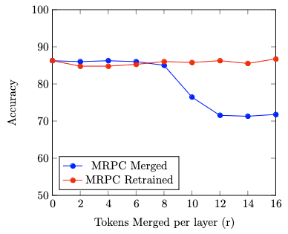
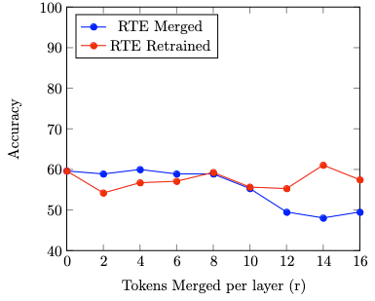
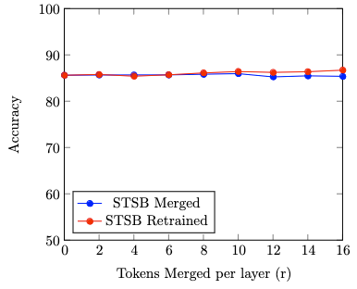
GLUE Tasks
256 latents, 26 self-attention layers, input sequence length 2048

Slide 11
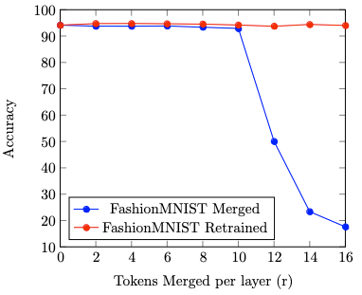
FashionMNIST
512 latents, 48 self-attention layers
Input size 3x224x224

Slide 12
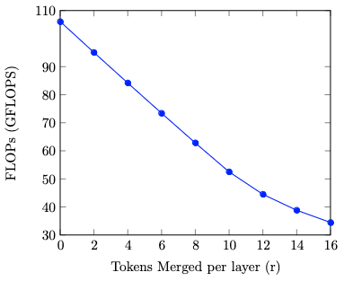
FLOPs/Throughput Improvement

Slide 13
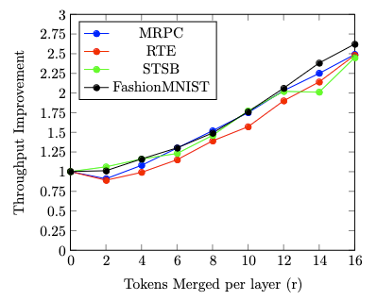
Throughput Improvement

Slide 14
Results
Lose ~1% accuracy at r=8, 1.5x throughput improvement
After retraining, maintain/improve accuracy
2.5 throughput improvement
106 GFLOPS -> 34 GFLOPS

Slide 15
Insights
Exploit redundancy in latents
Works for both language and vision tasks
Able to handle long input sequences

Slide 16
Questions?

